Slide 1
Present Simple

Slide 2
Present Simple
это настоящее простое время
используется, когда действие повторяется регулярно, постоянно, всегда, каждый день/каждую неделю/каждый месяц, часто, обычно
в 3 лице единственного числа к глаголу добавляется окончание –s или –es
Вспомогательные глаголы - do/ does

Slide 3
Present Simple утвердительные предложения
Лицо | Единственное число | Множественное число
1 | I like English | We like English
2 | You like English | You like English
3 | He likes English | They like English
 | She likes English
 | It likes English

Slide 4
Present Simple утвердительные предложения
Лицо | Единственное число | Множественное число
1 | I go to school | We go to school
2 | You go to school | You go to school
3 | He goes to school | They go to school
 | She goes to school
 | It goes to school

Slide 5
Вставьте глаголы в правильной форме: нет окончания/ -s или -es
I … exercises every day (do).
He … dogs (love).
You … the car well (drive).
She … a book every evening (read).
It … milk and fish (like).
do
We … very bad (swim).
They … a horse on Sunday (ride).
He … 3 hamsters at home (have).
This rabbit … so cute (be).
Polly … at six o’clock (dance).
swim
loves
ride
drive
has
reads
is
likes
dances

Slide 6
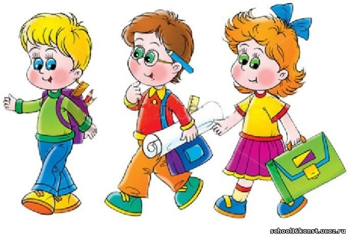
Present Simple вопросительные предложения
Лицо | Единственное число | Множественное число
1 | Do I go to school? | Do we go to school?
2 | Do you go to school? | Do you go to school?
3 | Does he go to college? | Do they go to school?
 | Does she go to college?
 | Does it go to college?

Slide 7
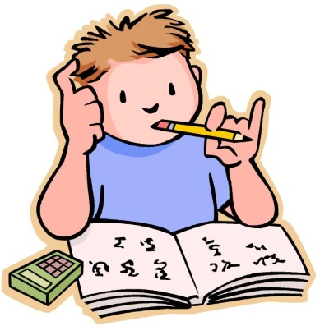
Present Simple краткие ответы
Лицо | Единственное число | Множественное число
1 | Yes, I do/No, I don’t. | Yes, we do/No, we don’t.
2 | Yes, you do/No, you don’t. | Yes, you do/No, you don’t.
3 | Yes, he does/No, he doesn’t. | Yes, they do/No, they don’t.
 | Yes, she does/No, she doesn’t.
 | Yes, it does/No, it doesn’t.

Slide 8
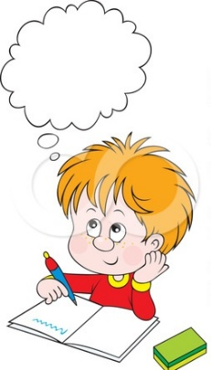
Сделайте предложения вопросительными
You speak good English.
She helps her mother to clean the house every Saturday.
We like to play tennis.
She has 2 brothers.
Do you speak English?
I read books every evening.
They have four pets at home.
He rides a bike very well.
It eats only milk.
You like to skate and to ski.
Do I read books every evening?
Does she help her mother to clean the house every Saturday?
Do they have 4 pets at home?
Does he ride a bike very well?
Do we like to play tennis?
Does it eat only milk?
Does she have 2 brothers?
Do you like to skate and to ski?

Slide 9
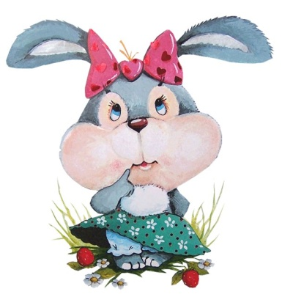
Ответьте на вопросы
Do you play football well?
Does she speak good English?
Do we go to school?
Do you like hamsters?
Does your mother cook cakes?
Does he ride a bike?
Do they have a dog?
Does your friend read books every day?
Does your cat eat fish?
Do you drive a car?

Slide 10
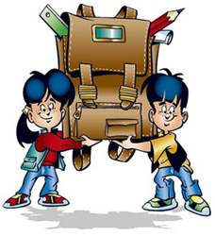
Present Simple отрицательные предложения
Лицо | Единственное число | Множественное число
1 | I don’t go to college | We don’t go to college
2 | You don’t go to college | You don’t go to college
3 | He doesn’t go to college | They don’t go to college
 | She doesn’t go to college
 | It doesn’t go to college

Slide 11
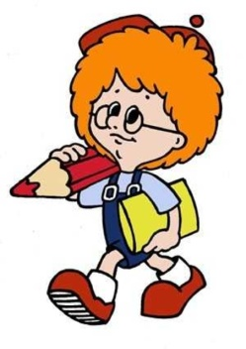
Сделайте предложения отрицательными
Mary and I don’t go to the cinema today.
Their friend doesn’t have a little monkey.
Mary and I go to the cinema today.
Jerry often swims in the lake.
This dog loves to run.
My mother cooks very well.
Tom, Jack and Peter play football every weekend.
Their friend has a little monkey.
You ride a bike only in the park.
Sue likes to cook cakes.
I meet my friends in the evening.
Her cat has 5 kittens.
Jerry doesn’t often swim in the lake.
You don’t ride a bike only in the park.
This dog doesn’t love to run.
Sue doesn’t like to cook cakes.
I don’t meet my friends in the evening.
My mother doesn’t cook very well.
Tom, Jack and Peter don’t play football every weekend.
Her cat doesn’t have 5 kittens.

Slide 12
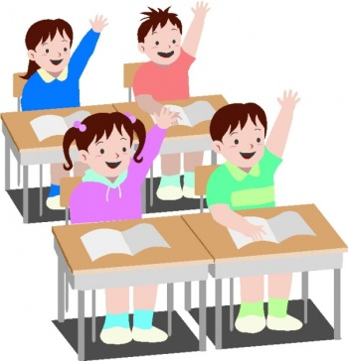
Выполните упражнение, используя время Present Simple
is
am
have
My name … Sam, Sam Griffin (be). I … ten (be). I … a family (have). We … from London (be). I … to school (go).My sisters … to school (not go), because they … only three and five years old (be).We … to play together (like).Dolly … to play with a ball (love) and Susan … to play with our dog (like). They often … by the house (run).Susan and I … a bike every weekend (ride).Dolly … a bike well (not ride).She … sweets and cakes very well (eat)! I … brothers (not have).Our mother … so nice cakes (cook). The father …a good tennis player (be).He … me (teach), but I … tennis well (not play). I … football (like). … you like football, tennis or cakes? (do/does)
are
go
don’t go
are
like
loves
likes
run
ride
doesn’t ride
eats
don’t have
cooks
is
teaches
don’t play
like
Do

