Slide 1
The 11th of September, Monday.
WHO ARE YOU?
Module 1.
1b
Таранцова Евгения Олеговна
МБОУ г. Иркутска СОШ №10 им. П. А. Пономарёва

Slide 2
Student’s book:
Ex. 4, p. 7.

Slide 3
appearance |əˈpɪər(ə)ns|
age
hair
Everest Cantu
height
Drew Holloway
weight
facial features
Morgan Maxwell
|heə|
Marketing
Business Head
|weɪt|
Manager
|eɪdʒ|
|haɪt|
|ˈfeɪʃ(ə)l ˈfiːtʃəz|

Slide 4
Workbook:
Ex. 1, 2, p. 4.

Slide 5
Student’s book
Ex.6, p. 7
Grammar Reference
Section - Gr1

Slide 6
Workbook:
Ex. 1, p. 5

Slide 7
old
parents
dark
father
tall
brother
short
sister
children
uncle
big
aunt
young
long
twins
slim
grey
grandfather
grandmother
wavy

Slide 8
Workbook:
Ex. 2, p. 5

Slide 9
1. Beth’s hair is short. Her eyes are green.
2. Peter’s hair is straight. His eyes are green.
3. Loise’s hair is wavy. Her eyes are dark.
4. Mike’s hair is dark. His eyes are brown.
5. Kate’s hair is fair. Her eyes are blue.

Slide 10
Today we are going to study forms of identification.
You will learn how to get
a membership card.
01
02
03
04
05
06
07

Slide 11
Forms of identification
01
a credit card
«Формы удостоверения личности»
an identity card
02
03
a membership card
a driving licence
04

Slide 12
Student’s book: Ex. 1, p. 8
a) Look at the cards. Which is a credit card? an identity card?
a membership card? a driving licence?
full name
expiry date
Your full name is your name and surname.
The expiry date is the end of the period when you can use the document.
home address
Your home address is the details of the place where you live.
postcode
nationality
A postcode is a group of numbers and letters that shows the exact area where someone lives.
Your nationality shows what country you are from.

Slide 13
Ex. 1с, p 8.
—Where and when do you need a membership card?
a membership cards of shops
a membership card of checkers
a membership card of fitness club
We need a membership card when we do shopping
We also need a membership card when we join a club
We also need a membership card when we use a gym or join a club

Slide 14
— Have you got a membership card?
When/Where did you last use it?

Slide 15
Ex. 2c, p. 8
—What do the words in bold mean?
Choose the correct item.
Hello, how can I help you?
...to join the video club.
That's it for now.
Here’s your card.
a) I don’t know how to help you.
b) What can I do for you?
a) to be a member of the video club
b) to work in the video club
a) an identity card
b) a membership card
a) I have finished
b) I will finish later

Slide 16
how can I help you?
Могу я чем-нибудь помочь?
join
Listening
присоединиться, вступить
Ex. 2a, p. 8
Who are the people talking about? Where are they?
that's it for now
вот и все на данный момент
card
карта

Slide 17
1.The language of Grammar – WL 1
to learn new words
2. Workbook – Ex. 1, 2, p. 6.

Slide 18
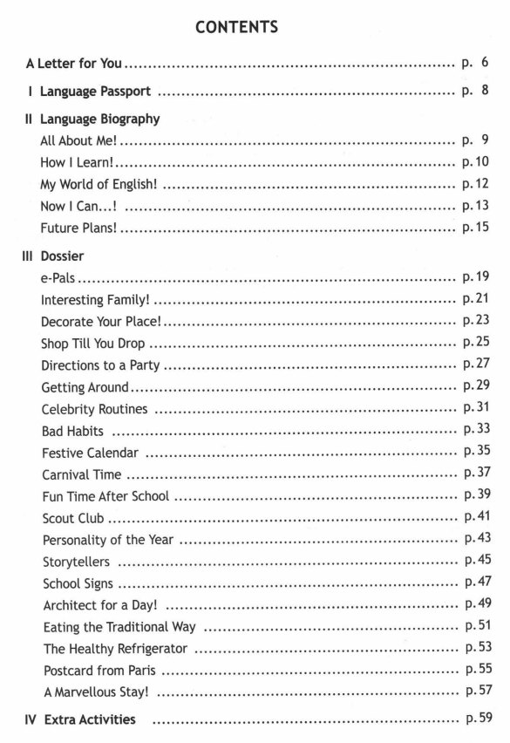
Stakeholders
Identify the important stakeholders concerned with the project.
Internal Stakeholder
External Stakeholder
Priority Stakeholder
Stakeholder Name
Stakeholder Name
Stakeholder Name

Slide 19
THANK YOU
for your work!

